Slide 1

Virtual DSO
15MH327E – Virtual Instrumentation
Tanmay Samak [RA1711018010101]
Chinmay Samak [RA1711018010102]

Slide 2
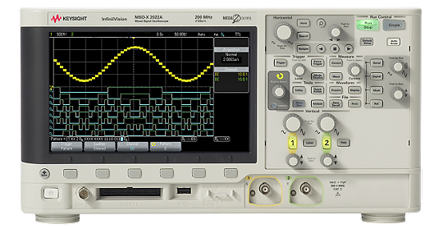
Oscilloscopes
Signal measurement and analysis
Types
  Cathode Ray Oscilloscope (CRO)
  Dual Beam Oscilloscope
  Analog Storage Oscilloscope
  Digital Storage Oscilloscope (DSO)
  Mixed Signal Oscilloscope (MSO)

Slide 3
Why Virtual Instrumentation?
Conventional Instruments
  Bulky
  Higher cost
  Limited upgrades
  High maintenance
Virtual Instruments
  Virtual
  Cost-effective
  Easily upgradable
  Low maintenance
  Multiple VIs on same device

Slide 4
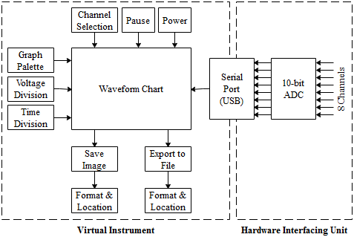
System Architecture

Slide 5
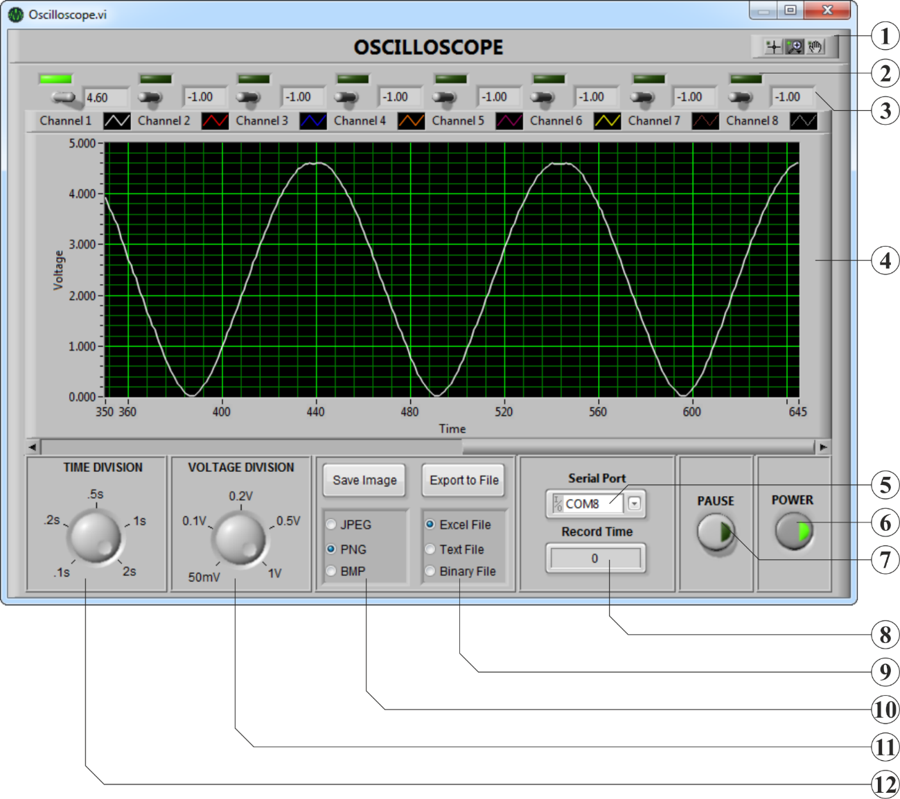
Virtual Instrument
Label | Description
1 | Graph Palette is used to move cursors, zoom and pan the graph.
2 | Indicator LED indicates whether the channel is active or not.
3 | Channel Readout displays the instantaneous voltage value.
4 | Waveform Chart displays the real-time waveform.
5 | Serial Port is used to select the COM Port for connection.
6 | Power Button is used to switch the VI on or off.
7 | Pause Button is used to pause the waveform.
8 | Record Time is the time through which data has been exported.
9 | Export to File is used to write data to a specified file format.
10 | Save Image is used to export the instantaneous image of the VI.
11 | Voltage Division is used to adjust the vertical divisions.
12 | Time Division is used to adjust the horizontal divisions.

Slide 6
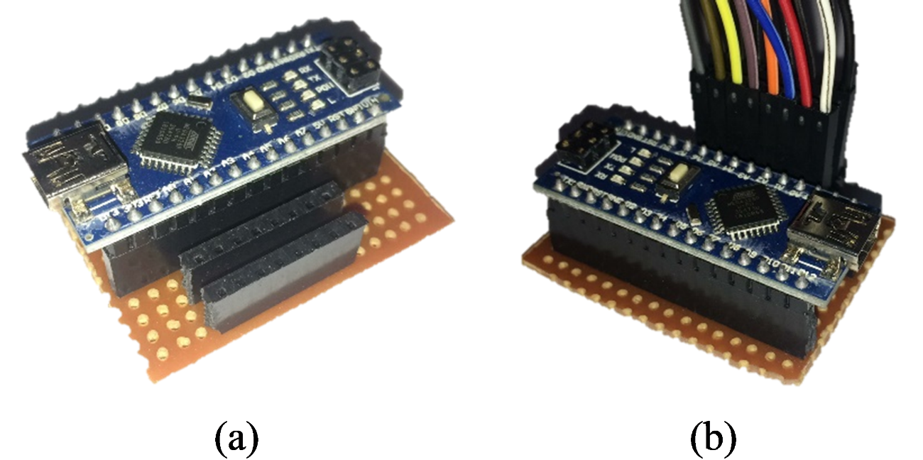
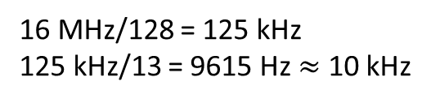
Hardware Interfacing Unit
Arduino Nano – ATmega328P
  8-bit AVR RISC architecture
  32 kB flash memory
  Low power mode
  16 MHz clock frequency
  10-bit ADC
    6-channel in DIP
    8-channel in TQFP
  Effective sampling rate
16 MHz/128 = 125 kHz
125 kHz/13 = 9615 Hz $≈$ 10 kHz

Slide 7
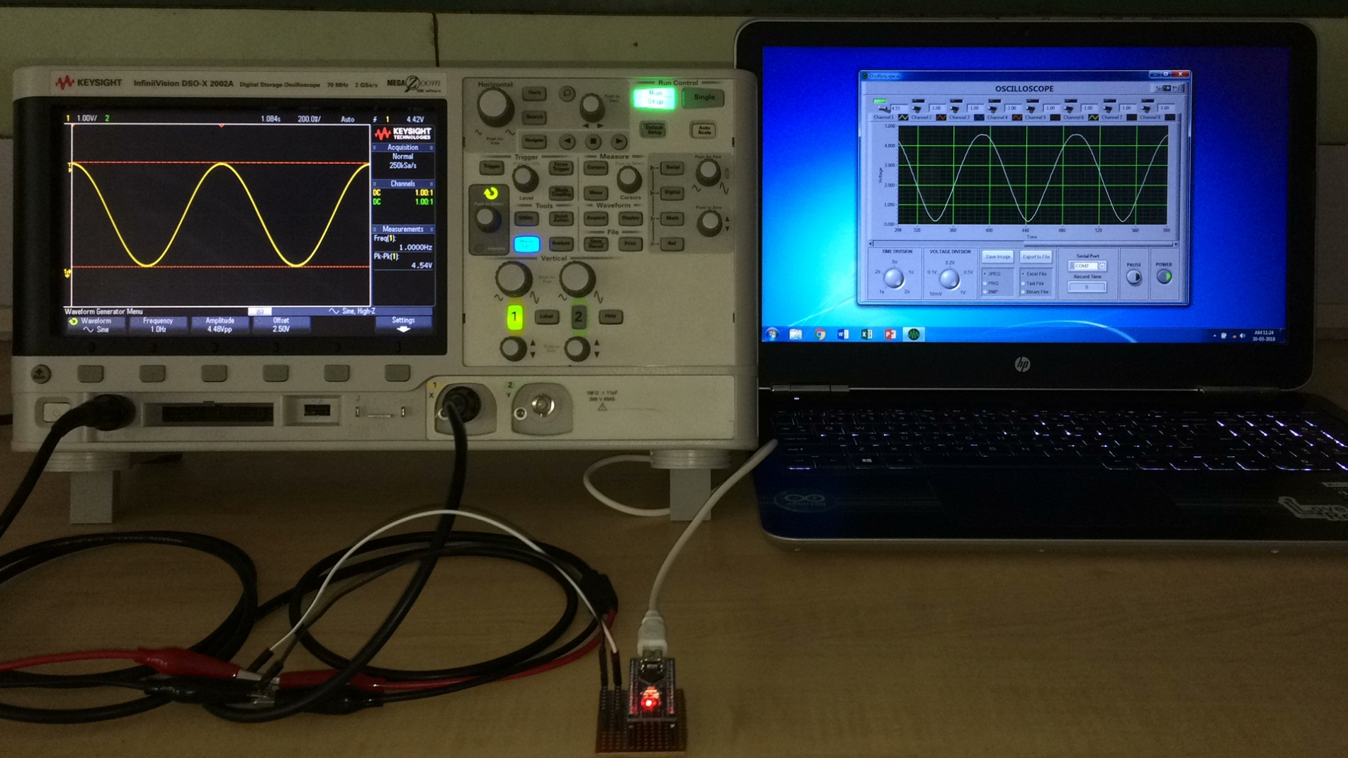
Demo

Slide 8
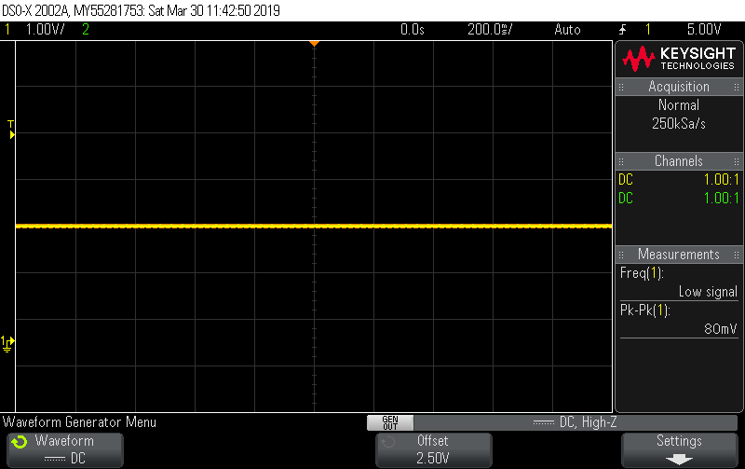
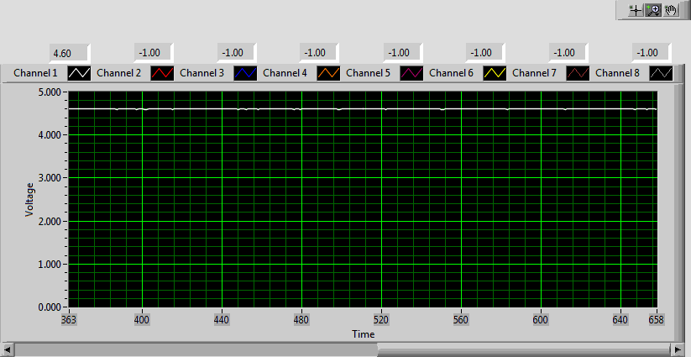
DC Waveform
Keysight InfiniiVision DSO-X 2002A Virtual DSO

Slide 9
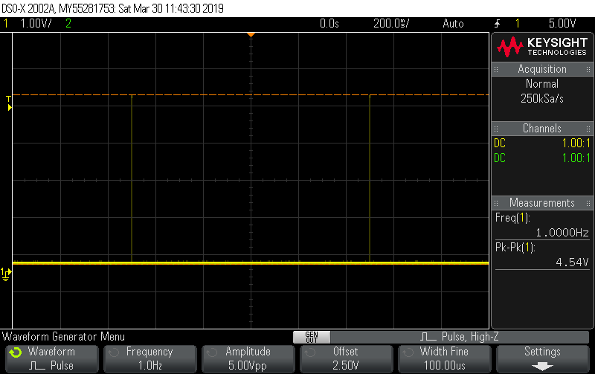
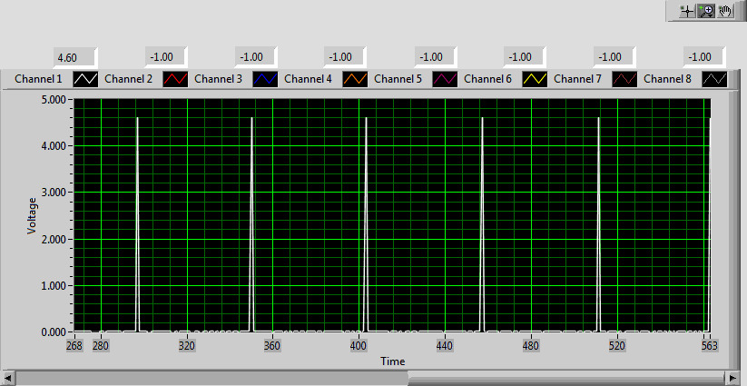
Pulse Waveform
Keysight InfiniiVision DSO-X 2002A Virtual DSO

Slide 10
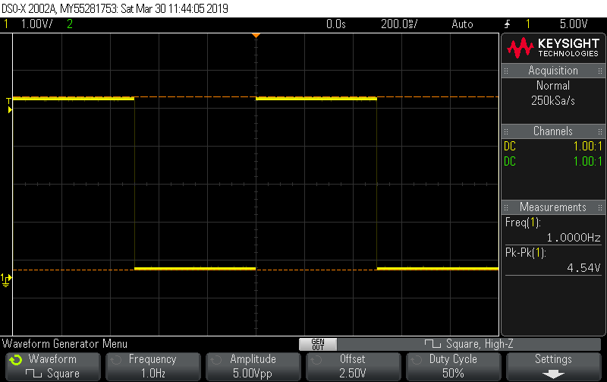
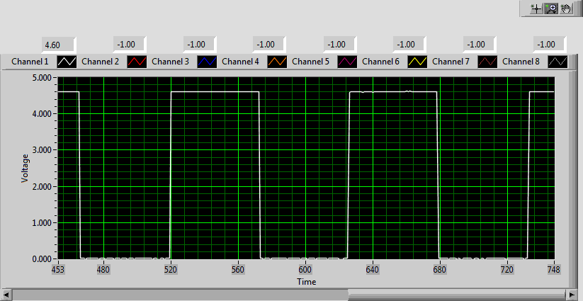
Square Waveform
Keysight InfiniiVision DSO-X 2002A Virtual DSO

Slide 11
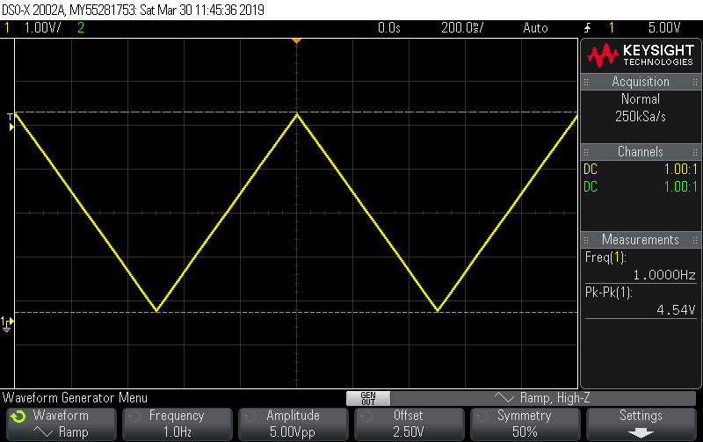
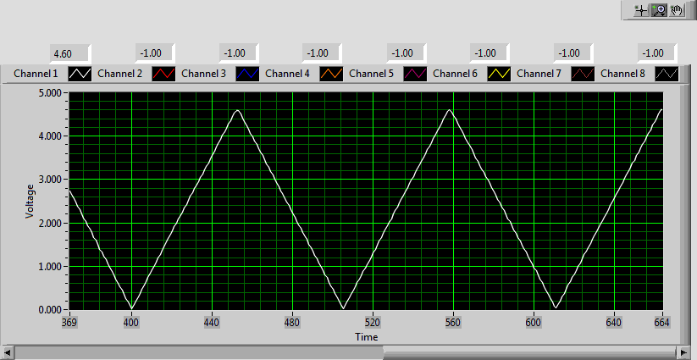
Triangular Waveform
Keysight InfiniiVision DSO-X 2002A Virtual DSO

Slide 12
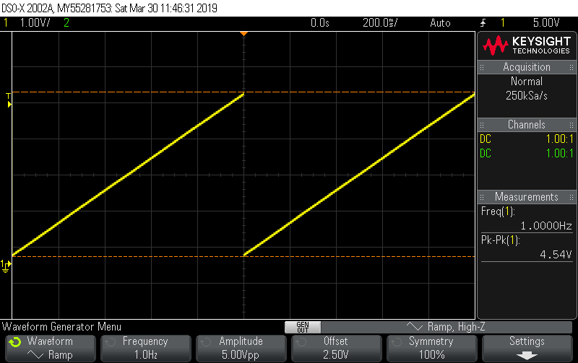
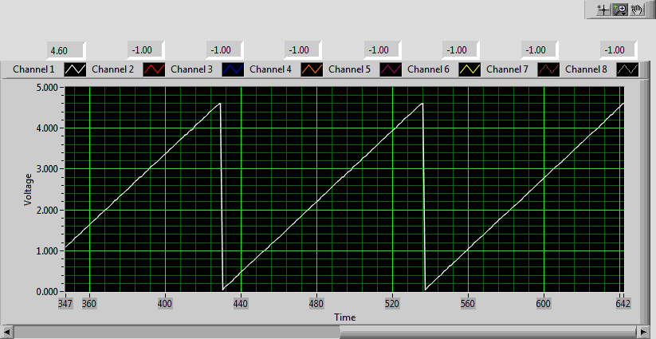
Sawtooth Waveform
Keysight InfiniiVision DSO-X 2002A Virtual DSO

Slide 13
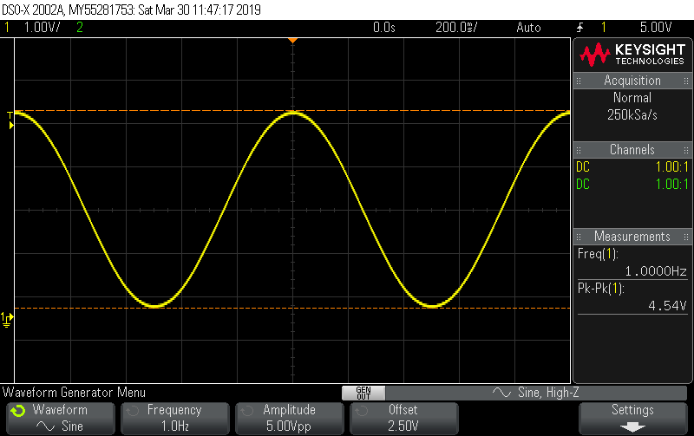
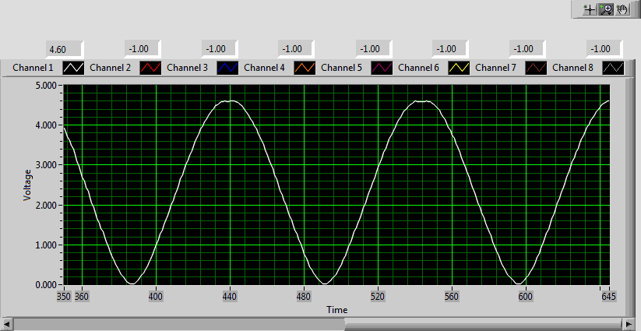
Sine Waveform
Keysight InfiniiVision DSO-X 2002A Virtual DSO

Slide 14
Results
Arbitrary Waveform Generator (AWG):
  Amplitude: 5 V
  Offset: 2.5 V
  Frequency: 1 Hz
Signal | Keysight DSO |  | Virtual DSO
 | V_{p-p} | Frequency | V_{p-p} | Frequency
DC | 80 mV | - | 100 mV | -
Pulse | 4.54 V | 1.00 Hz | 4.60 V | 1.00 Hz
Square | 4.54 V | 1.00 Hz | 4.60 V | 1.00 Hz
Triangle | 4.54 V | 1.00 Hz | 4.60 V | 1.00 Hz
Sawtooth | 4.54 V | 1.00 Hz | 4.60 V | 1.00 Hz
Sine | 4.54 V | 1.00 Hz | 4.60 V | 1.00 Hz

Slide 15
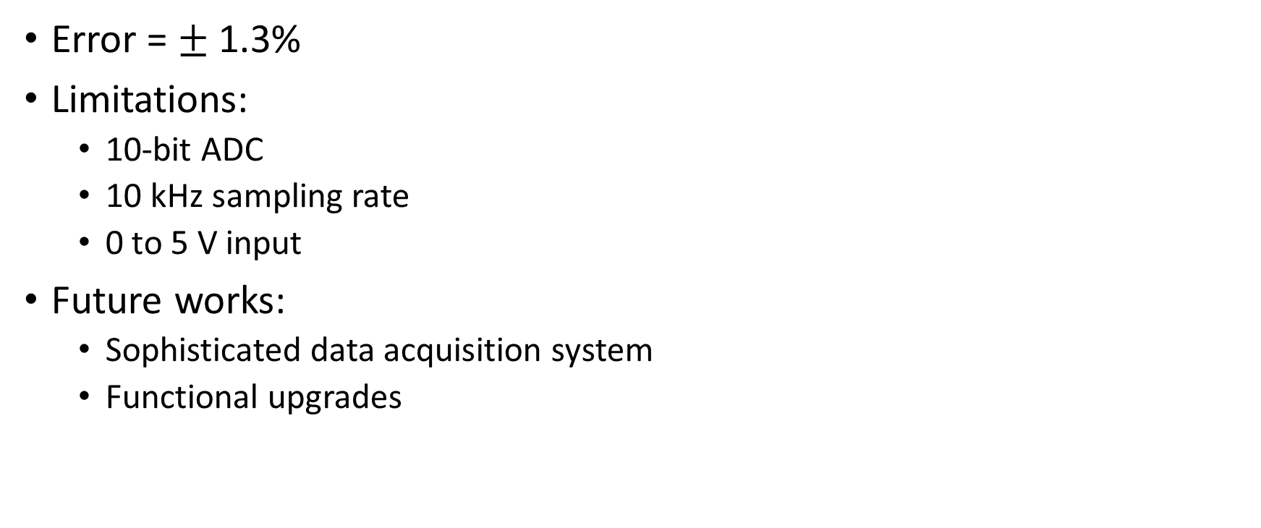
Conclusion
Error = $±$ 1.3%
Limitations:
  10-bit ADC
  10 kHz sampling rate
  0 to 5 V input
Future works:
  Sophisticated data acquisition system
  Functional upgrades

Slide 16
Thank You!

